Slide 1
Natural language toolkit (NLTK)
Eilidh Dunsmore

Slide 2

Introduction
What is NLTK?
What is it used for?
How to install

Slide 3
What is nltk
Created by Steven Bird, Edward Loper, and Ewan Klein
Contains more than fifty corpora and lexical sources
Notes:
Created by XYZ to be used in education
For use by its users including treebanks, thesauruses, wordnets, as well as text processing libraries for tokenization, parsing, classification, stemming, tagging, and semantic reasoning.

Slide 4

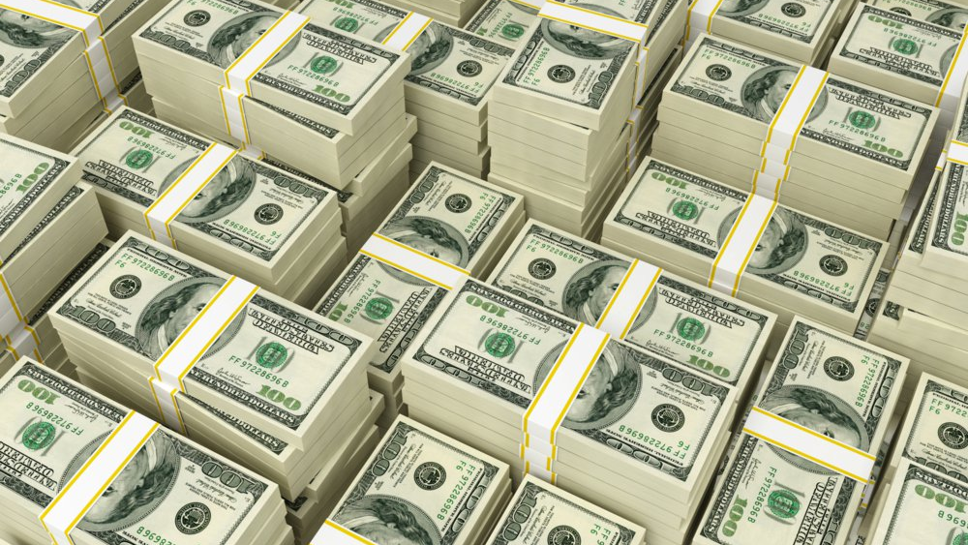
What is it used for?
Mostly to make money
But, like, maybe some academia too
Notes:
Researchers: etymology of slang, lexicographers trying to add new words to the dictionary, but mostly its companies
-determine product sentiment
-reaction to add campaigns
-monitor & capitalize off of trends and buzzwords

Slide 5
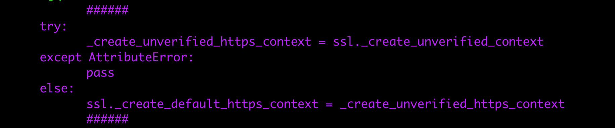
How to install
Know what version of Python you have
Install NLTK: >>> pip3 intall –U nltk
Deal with the inevitable error messages
One more installation: >>> nltk.download(‘stopwords’)
Have a Mac plz
Notes:
1. I have 3.7 & you should have at least 3.5 for this version to work (also: a mac)
2. Open terminal & type “pip3 intall –U nltk”
3. Open Sublime (or whatever), import nltk & try to run anything & receive a “certificate error”, naviate yourself to your Applications, Click Python, double click Install Certificates.command (it will install)
4. If that doesn’t work there’s code you can use to bypass the error, full disclosure: idk what it is or what it does or how it works
5. Have a Mac bc the best I can do is refer you to some vaguely-current websites detailing installation (this was the hardest, most difficult part to do)

Slide 6
Useful functions
Tokenization
Frequency Distribution
Stopwords
Lexicon Normalization

Slide 7
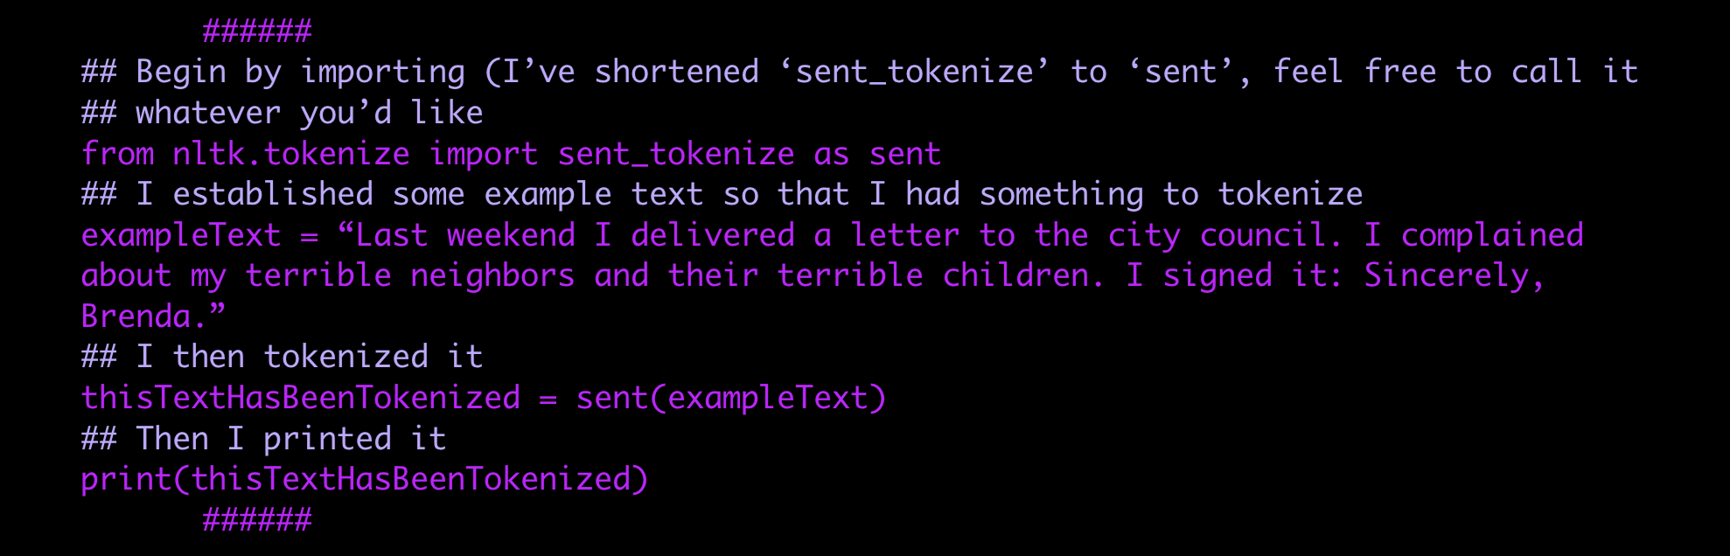
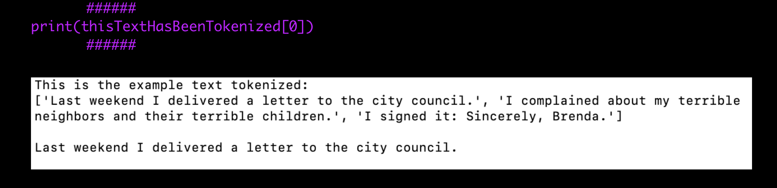
Tokenization
Sentence Tokenization
Word Tokenization
Notes:
Tokenization = “the act of breaking up a sequence of strings into pieces such as words, keywords, phrases, symbols, and other elements called tokens”
Tokens can be anything
Tokens = the basis of more complex programs, so you gotta understand what it does/how it works

Slide 8
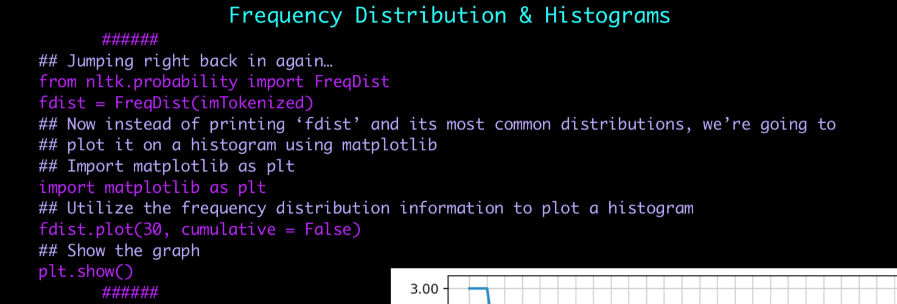
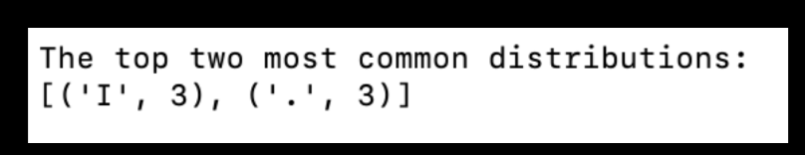
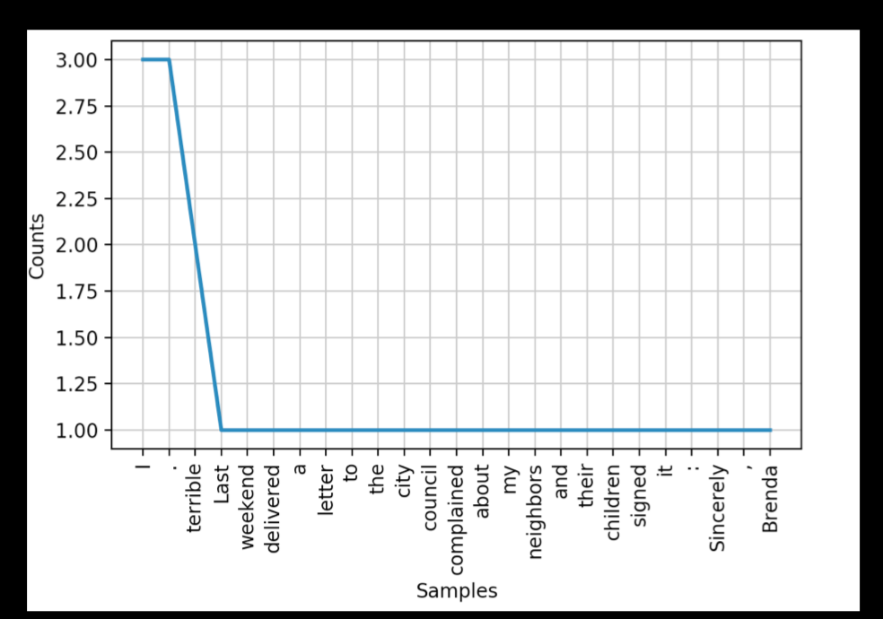
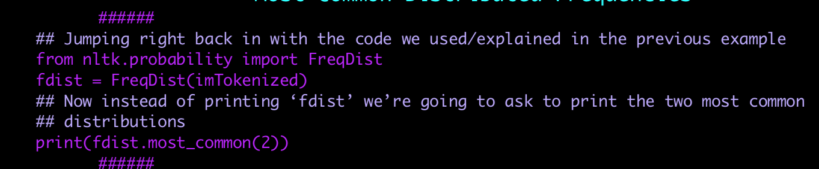
Frequency Distribution
Most Common Distributed Frequencies
Frequency Distribution & Histograms
Notes:
Demonstrating how frequencies are distributed over values
Histograms = used to measure the amount of times a data point occurs rather than the data itself

Slide 9
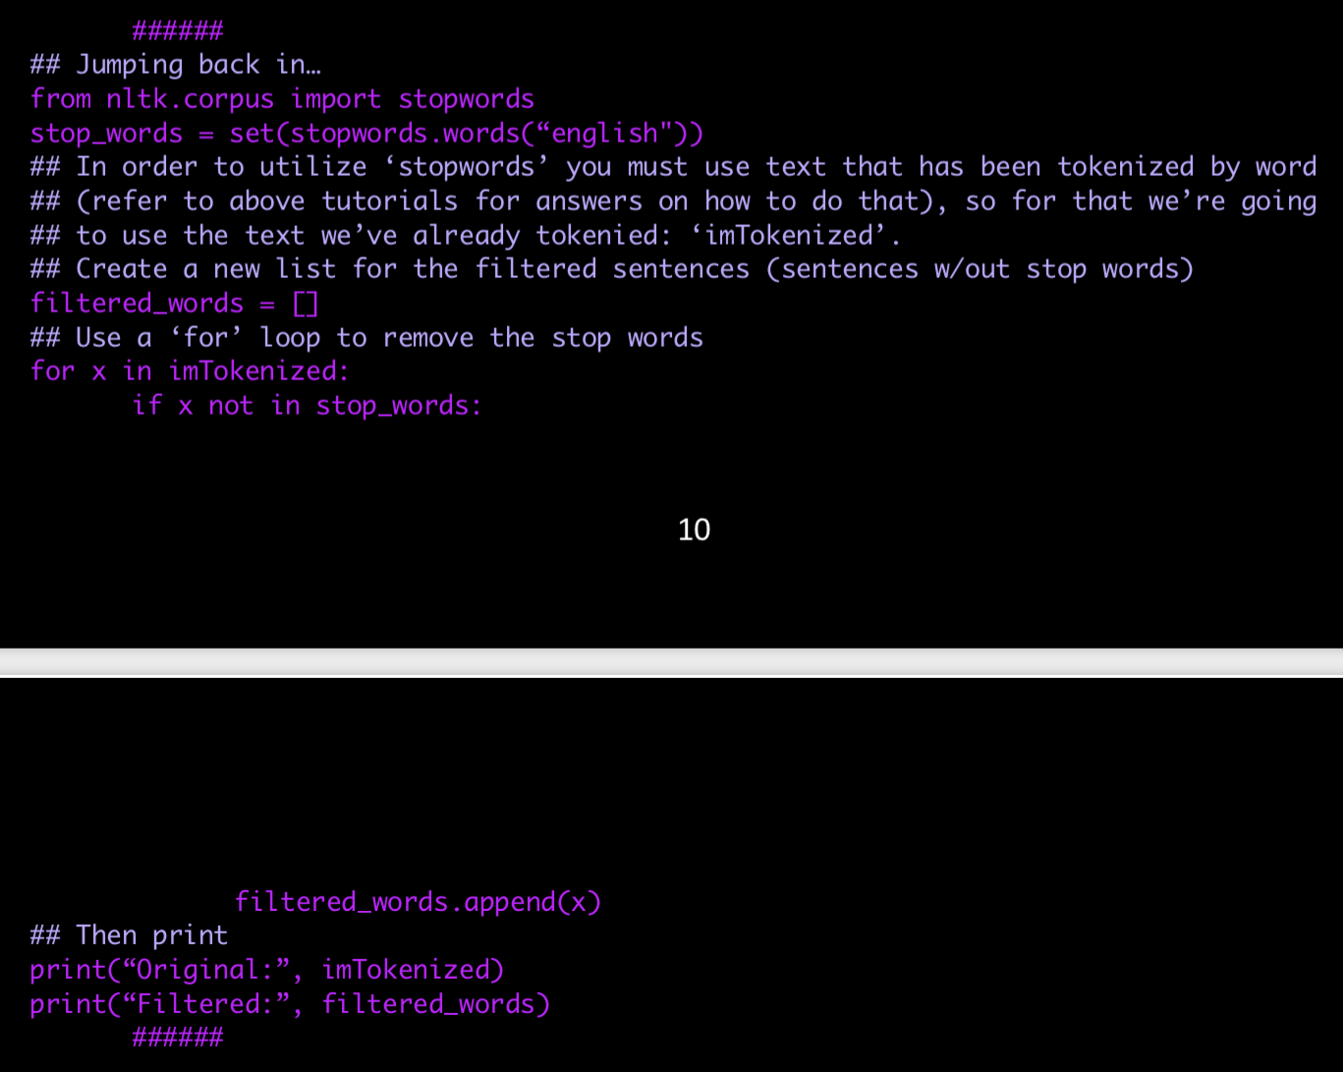
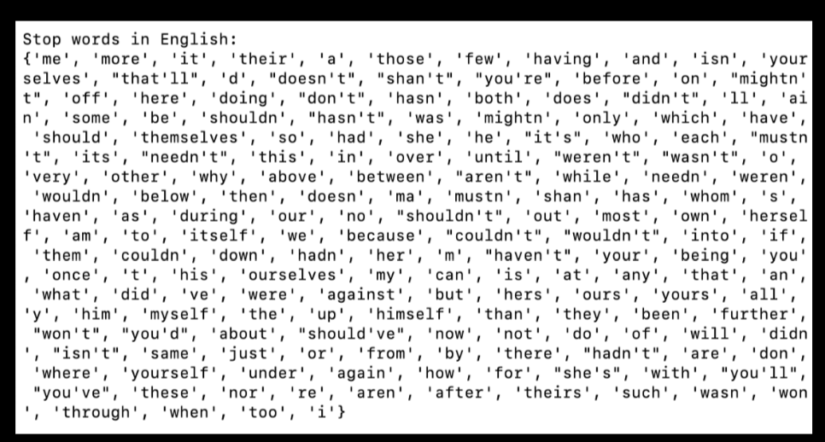
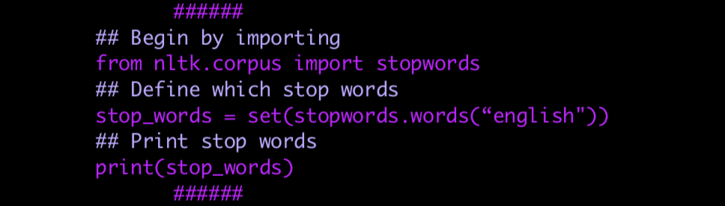
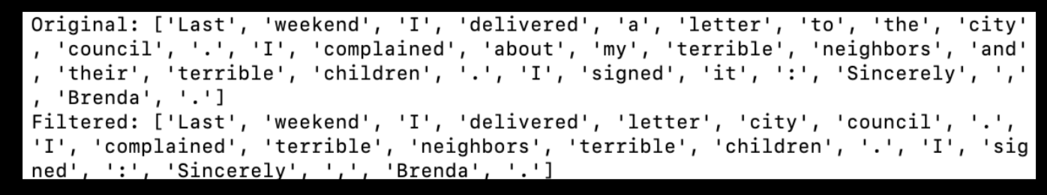
Stopwords
Language science & noise
Remove stop words
Notes:
“text noise”
Remove stop words for when you’re trying to map frequency distribution as it is unlikely that you’re interested in knowing that the most used token in your data set was “the”

Slide 10
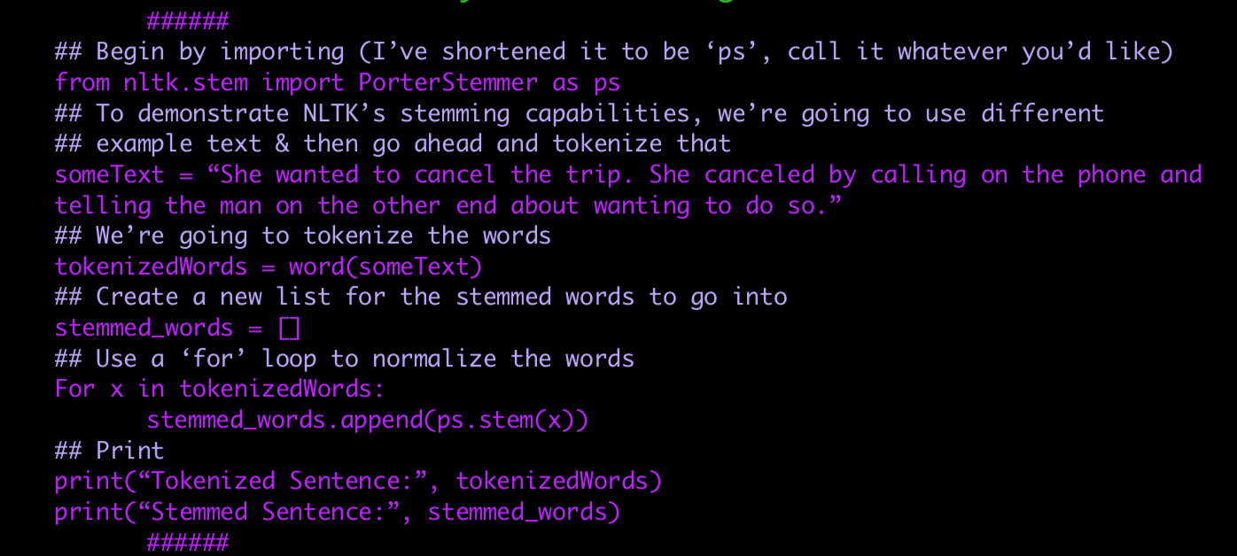
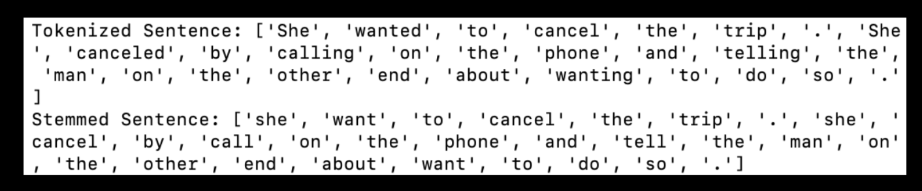
Lexicon Normalization
Trimming “normalizing” words down to their base/common root
Stemming
Notes:
Def: where “tokenization” is the process of separating a sequence into tokens, “normalization” is the steps taken to condense those terms into lexical units.
For our purposes: reducing linguistic noise, reduces derivationally related forms of a word to a common root word by chopping off its derivational affixes
Help -> helped
help

Slide 11
Cool stuff
Importing text sources
Sentiment gathering

Slide 12
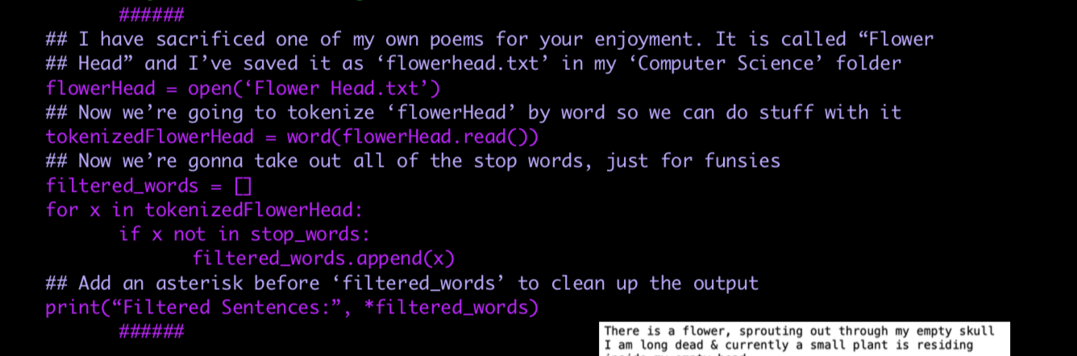
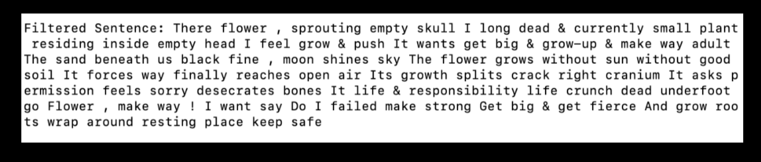
Importing text sources
Reading local files

Slide 13
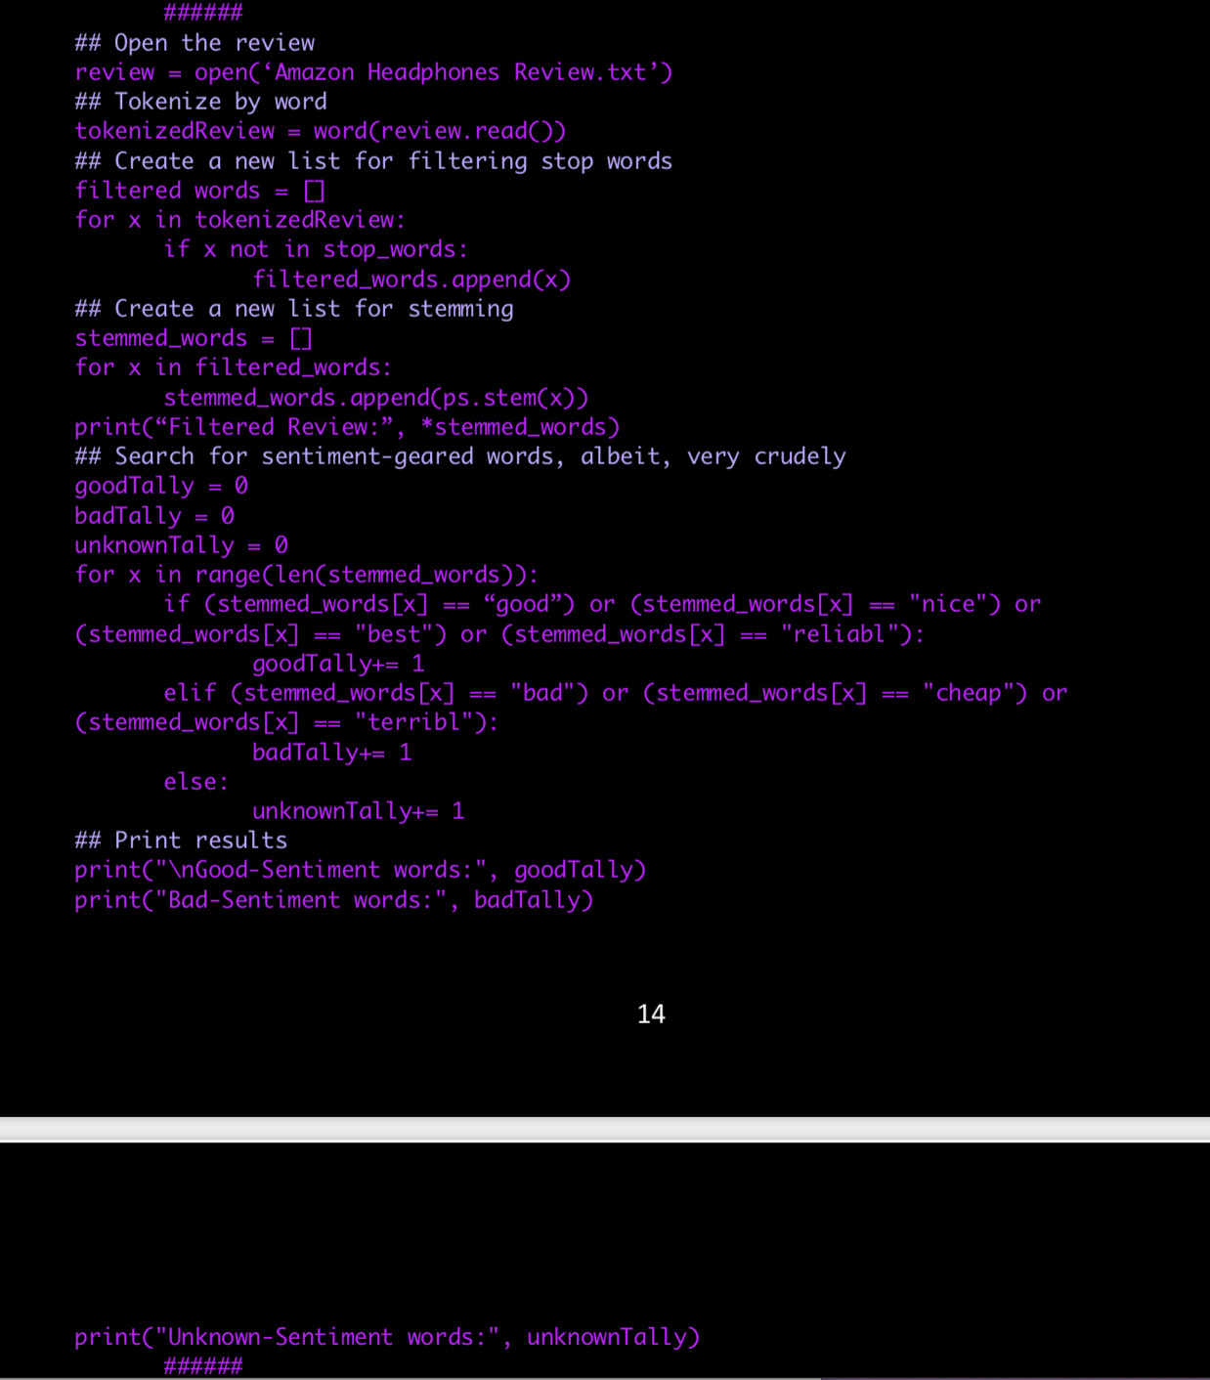
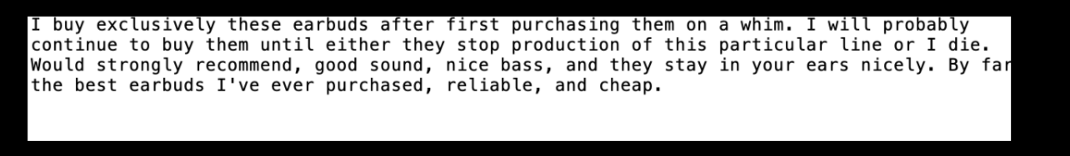
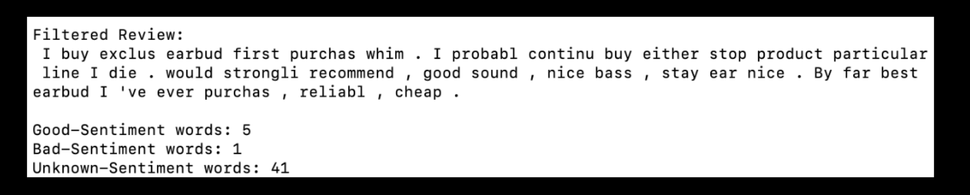
Sentiment gathering

